Slide 1
STA 695 Final Data Extraction by Web Scraping
Xue Ding, Miles Deaton, Isaac Nakamura

Slide 2
Motivation
Simple! Before we can analyze data, we need data!!
Web-scraping is a method to get data from internet.

Slide 3
Web Scraping
The automated gathering of data from the internet is nearly as old as the internet itself.
In practice, web scraping encompasses a wide variety of programming techniques and technologies, such as data analysis and information security.
Be careful. Some websites are illegal to scrape. Others are easier to work with.

Slide 4
Web Scraping & API
Some sites like Reddit, Twitter, and Facebook all offer certain data through their Application Program Interfaces, API. However, there are several reasons why an API might not exist:
You are gathering data across a collection of sites that do not have a cohesive API.
The data you want is fairly small, finite set that the webmaster did not think warranted an API.
The source does not have the infrastructure or technical ability to create an API.
Even when an API does exist, request volume and rate limits, the types of data, or the format of data that it provides might be insufficient for your purpose.

Slide 5
How Does Web Scraping Work?
Find data you want to analyze.
HTML table, images, pdf files, etc.
Because web scraping can be time consuming you may want to test code in a shell first.
Scrape your data.
Define some logic to “crawl” if data is on multiple pages
We can use more machine learning here!
Store the scraped data.
If we want we can use a time-based job scheduler “cron”
scrape data periodically at fixed times, dates.

Slide 6
How can we Web Scrape?
We can use Python or R among other languages.
R has at least one package to do it
However after scraping web-site, we need to change html table to a data.frame, so that we can analyze the data.
We will introduce both ways
First we need to inspect the HTML code that both of them will be scraping from.

Slide 7
HTML
Frequently, the data we want to scrape will be written in html. Thus it is important to understand the basics of HTML.
When websites are written, they put a file with .html extension on a server, and connect the html file with a web domain. There are web-hosting services that provide you both a server and domain. ( For example: https://www.hostgator.com/ )

Slide 8
Basic Structure HTML Page
HTML file should look like this:
<html>
<head> This is the head part</heard>
<body>This is the body part.
</body>
</html>

Slide 9
Structure of HTML table
Web-sites are written in language called HTML.
When we create tables, we write
<table><tr><td>(1,1)</td><td>(1,2)</td></tr>
<tr><td>(2,1)</td><td>(2,2)</td></tr>
</table>
To include images we can write
<img src="filename.png">

Slide 10
Examples of Data Scraping
We can use the package XML to scrape data.
For example: http://www.spotrac.com/nfl/rankings/
It is easy to scrape image files by using a package: ImageScraper! (https://pypi.org/project/ImageScraper/ )
pip install ImageScraper
image-scraper https://www.telegraph.co.uk/travel/safaris-and-wildlife/comedy-wildlife-photography-awards-2017/

Slide 11
Scrapy
So, as demonstrated, web scraping involves recognizing forms of data and grabbing information
Such as an html table
In a sense this is like a classification problem.
We have previously seen that machine learning algorithms are great at classification
One example is Scrapy, a free and open source web crawling framework in Python.
It can also work with APIs.
Scrapy works by defining “Spiders”, what better way to get around the web?!?

Slide 12
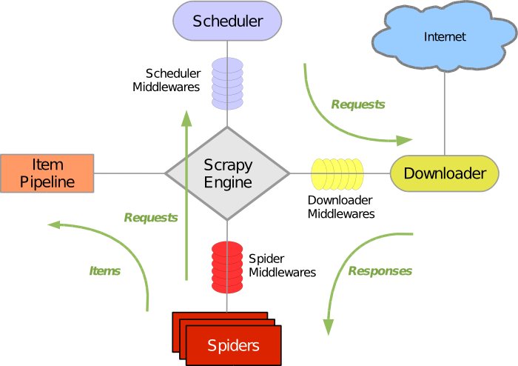
Infrastructure of Scrapy

Slide 13
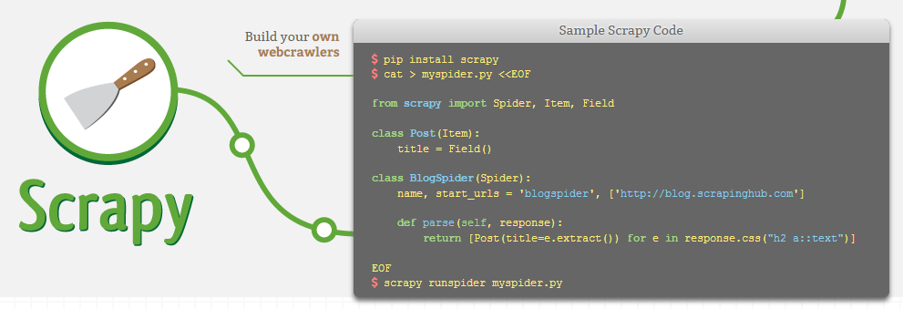
Basics of Scrapy

Slide 14
Portia
Another way to use scrapy is Portia.
Operated by scrapinghub, the maintainers of scrapy
It operates like a point and click scrapy.
Still in beta, can get a bit buggy
You select data you want yourself by highlighting samples.
Theoretically, it trains on the samples you provide and turns websites into classification problems.

Slide 15
References
Web Scraping with Python, Ryan Mitchell.
Wikipedia, Web scraping, https://en.wikipedia.org/wiki/Web_scraping
https://scrapy.org/
https://app.scrapinghub.com

Slide 16
Thank You!

